Slide 1
LIFE Out There?

Slide 2
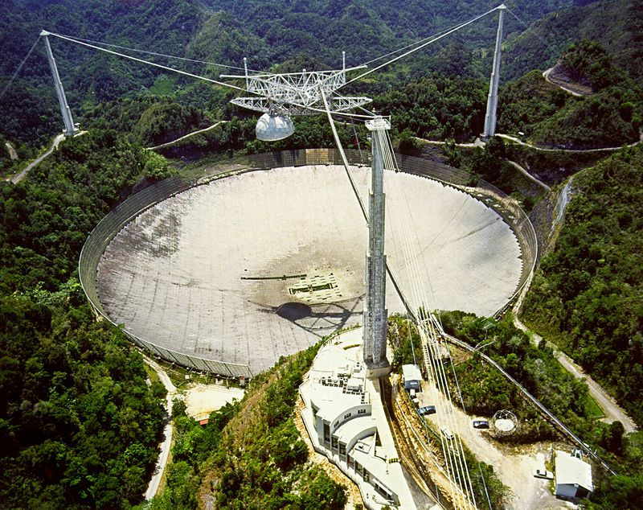
Arecibo Radio Telescope, at Arecibo, Puerto Rico. At 1000 feet (305 m) across, it is the second largest dish antenna in the world. The dish, built into a bowl in the landscape, focuses radio waves from the sky on the feed antenna suspended above it on cables.

Slide 3
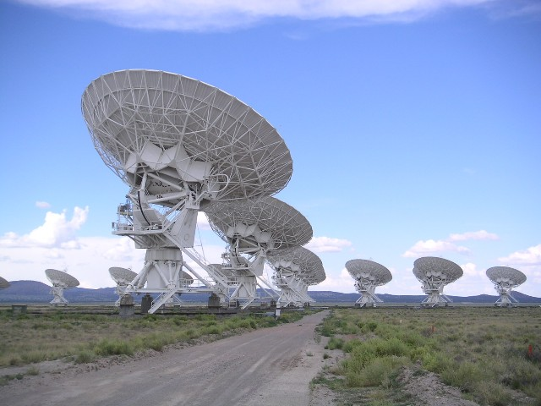
The Karl G. Jansky Very Large Array (VLA) is 27 independent antennae, each of which has a dish diameter of 25 meters (82 feet)

Slide 4
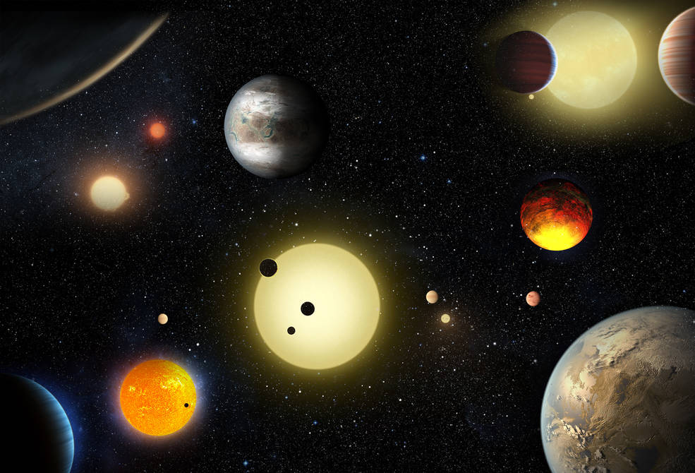
NASA's Kepler mission has verified 1,284 new planets – the single largest finding of planets to date.

Slide 5
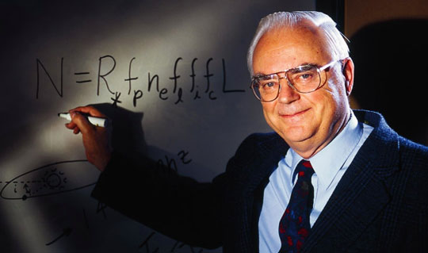
N = The number of detectable civilizations in the Milky Way Galaxy.
R* = The rate of formation of stars suitable for the development of intelligent life.
f_{p} = The fraction of those stars with planetary systems.
n_{e} = The number of planets, per solar system, with an environment suitable for life.
f_{l} = The fraction of suitable planets on which life actually appears.
f_{i} = The fraction of life bearing planets on which intelligent life emerges.
f_{c} = The fraction of civilizations that develop a technology that releases detectable signs of their existence into space.
L = The length of time such civilizations release detectable signals into space.
The Drake Equation

Slide 6
The Drake Equation

Slide 7
Are UFO accounts real? Well, if there is life where is it?

Slide 8
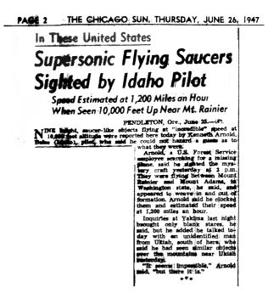
On June 24, 1947, while flying near Mt. Rainier in Washington State, Arnold claimed to have seen nine unusual objects flying in the skies. Arnold also claimed to have seen UFOs on several subsequent occasions.

Slide 9
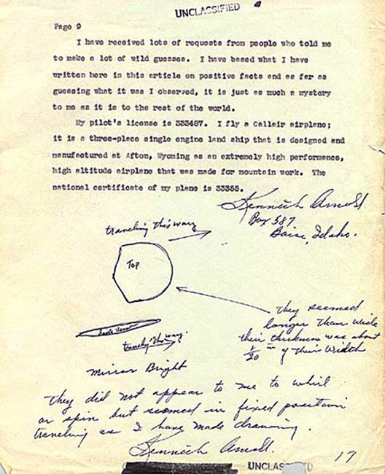
Ken Arnold’s account and drawing

Slide 10
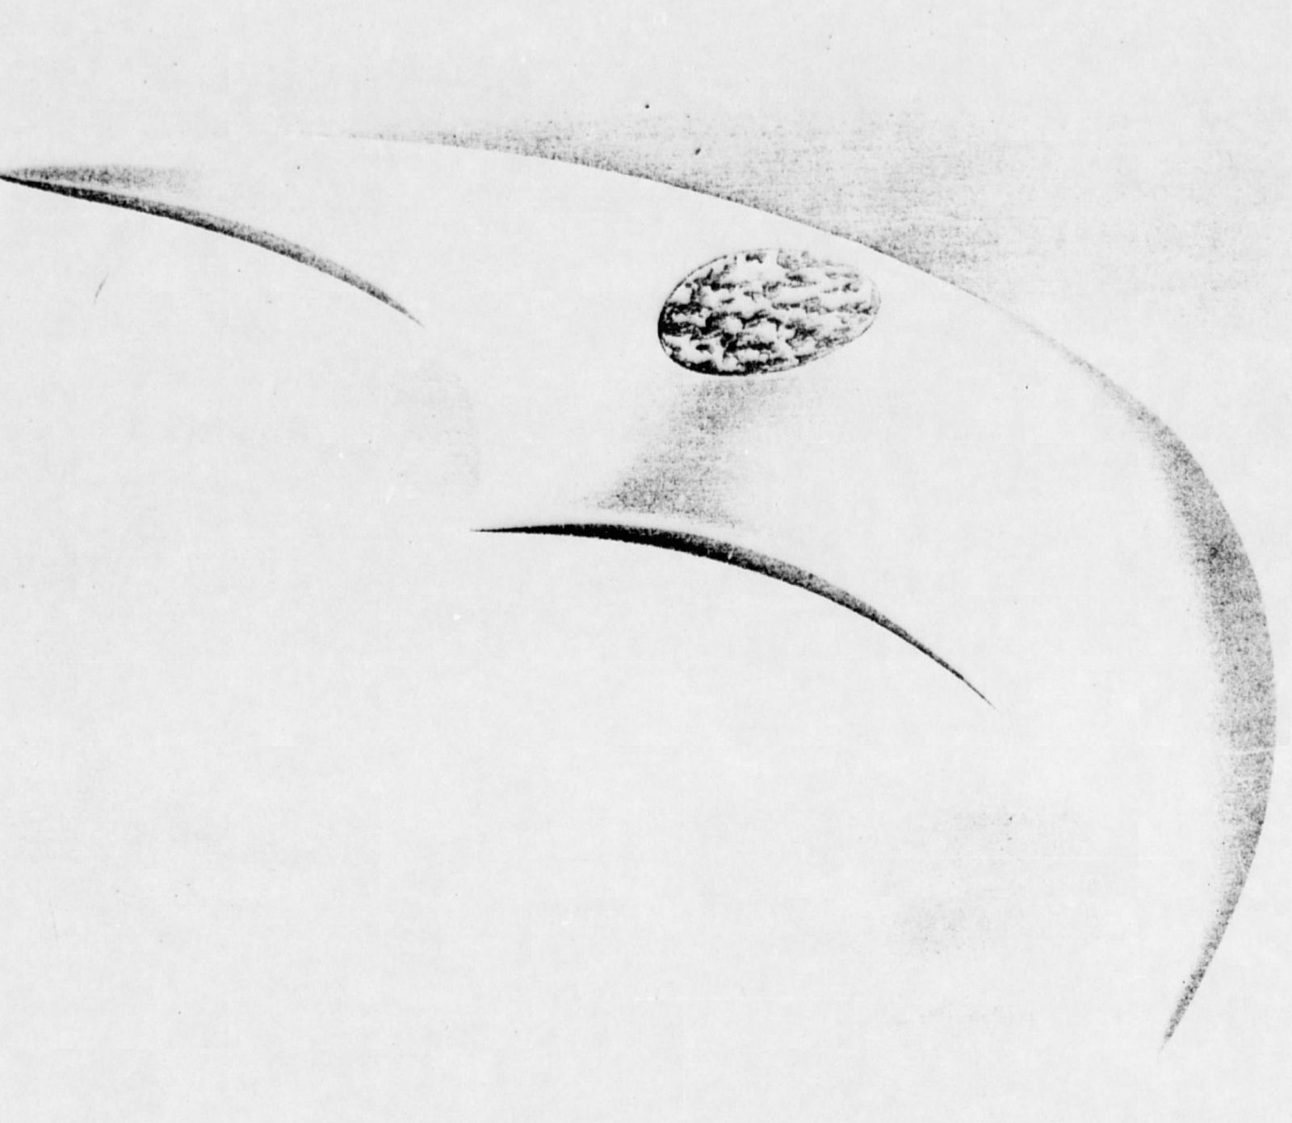
Ken Arnold’s UFO from artist

Slide 11
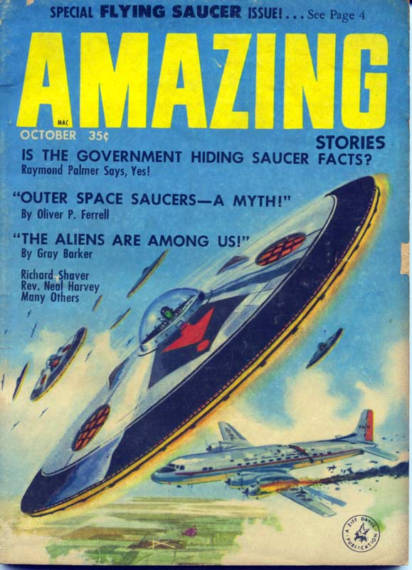

Slide 12
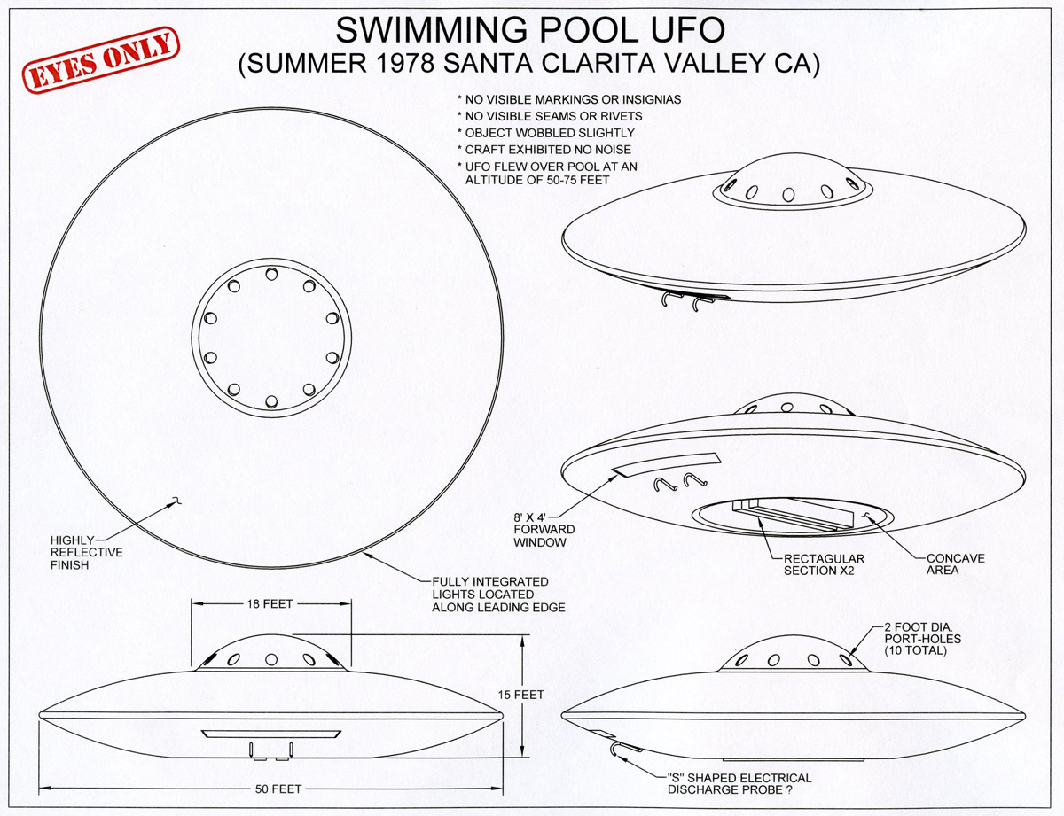
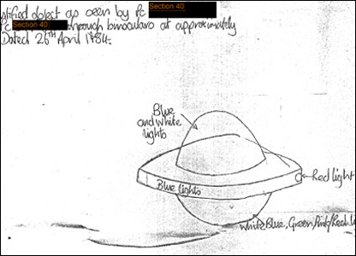

Slide 13
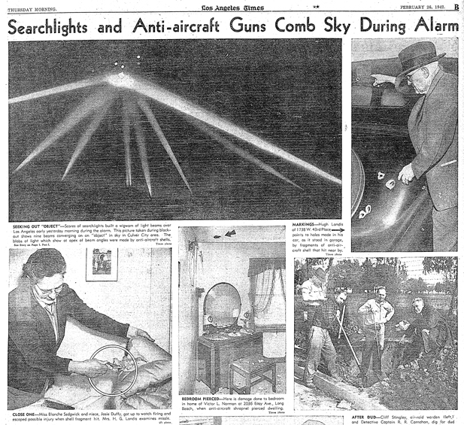
The Battle of Los Angeles, also known as The Great Los Angeles Air Raid, is the name given by contemporary sources to the rumored enemy attack and subsequent anti-aircraft artillery barrage which took place from late 24 February to early 25 February 1942 over Los Angeles, California.

Slide 16
Alien Autopsy

Slide 17
The Fermi Paradox

